Slide 1
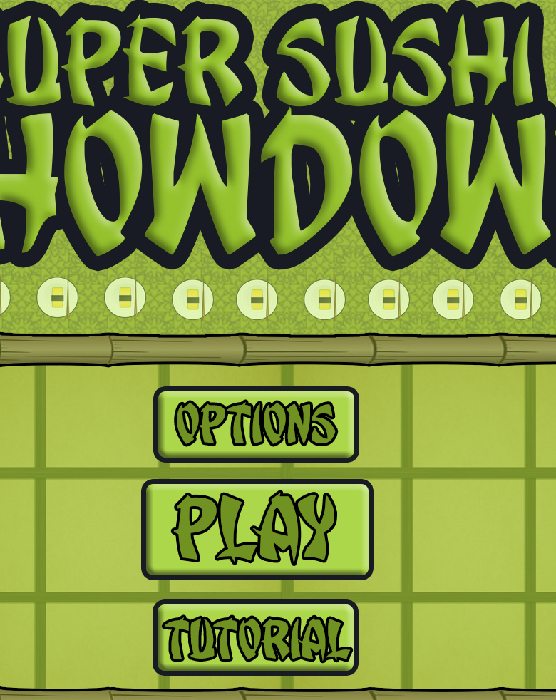
Bandai Namco Group 5 Second Pitch
Henry Crofts, Ashley Long, Samuel McMillan and Dawid Hojka

Slide 2
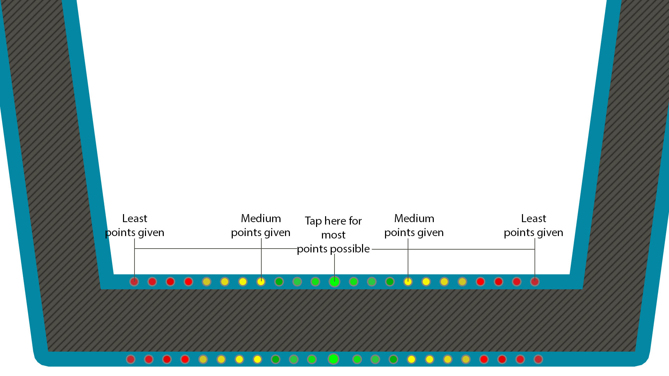
Brief Overview
Theme of game
Idea of game
Twitch / matching

Slide 3
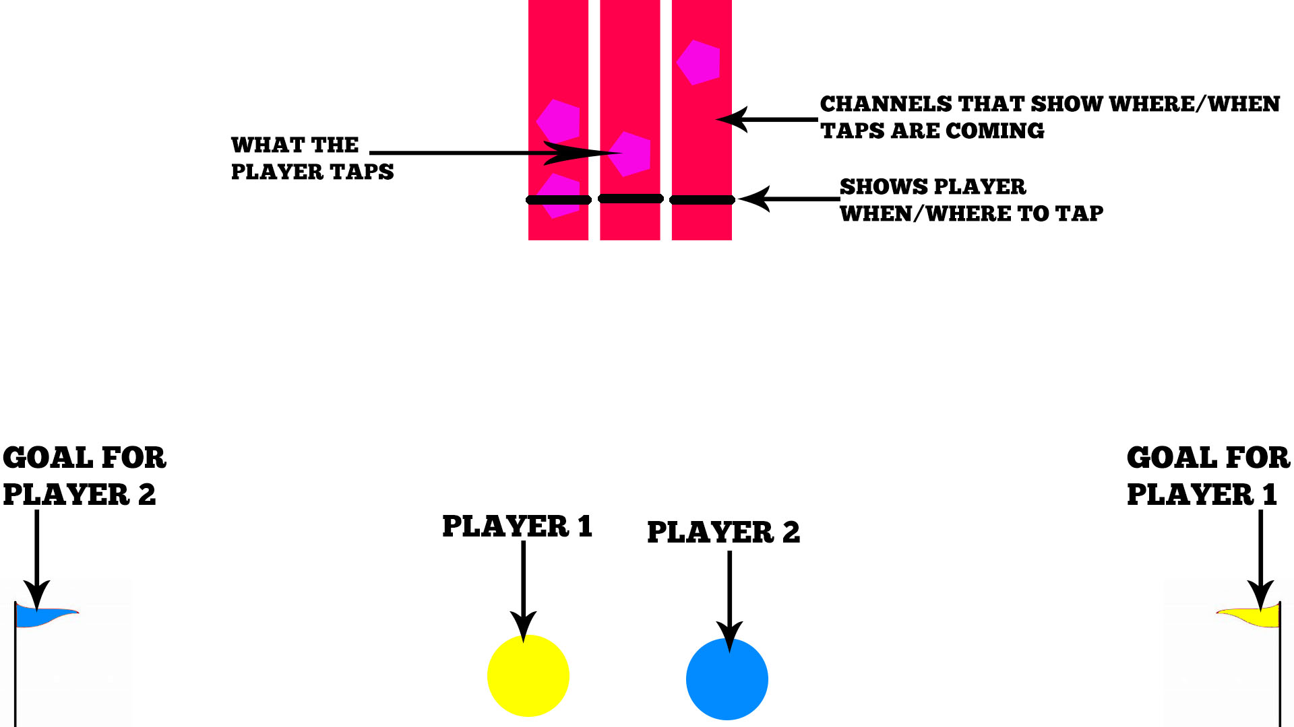

Iterations
Picture 1:
Nodes falling down
Reverse Tug of War
Picture 2:
Background
Theme

Slide 4
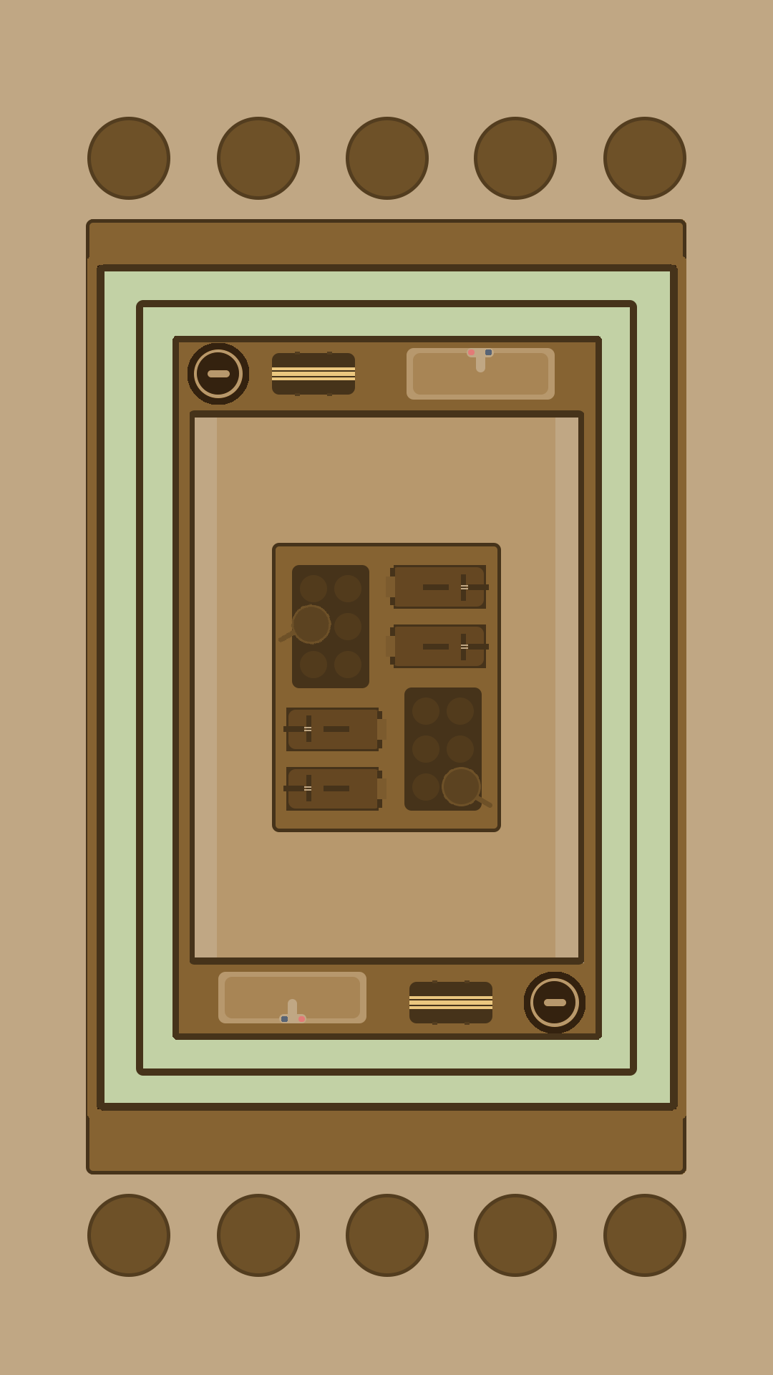
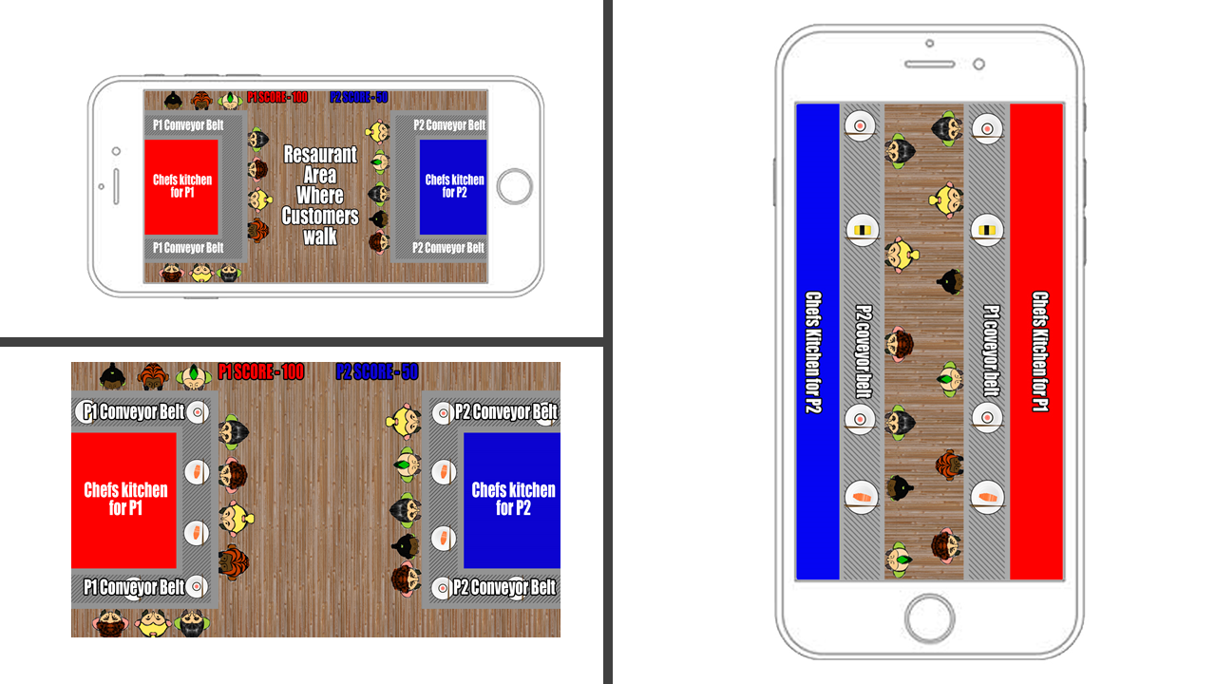
Iterations Continued
Other design ideas not yet spoken about
Where the game is at now

Slide 5
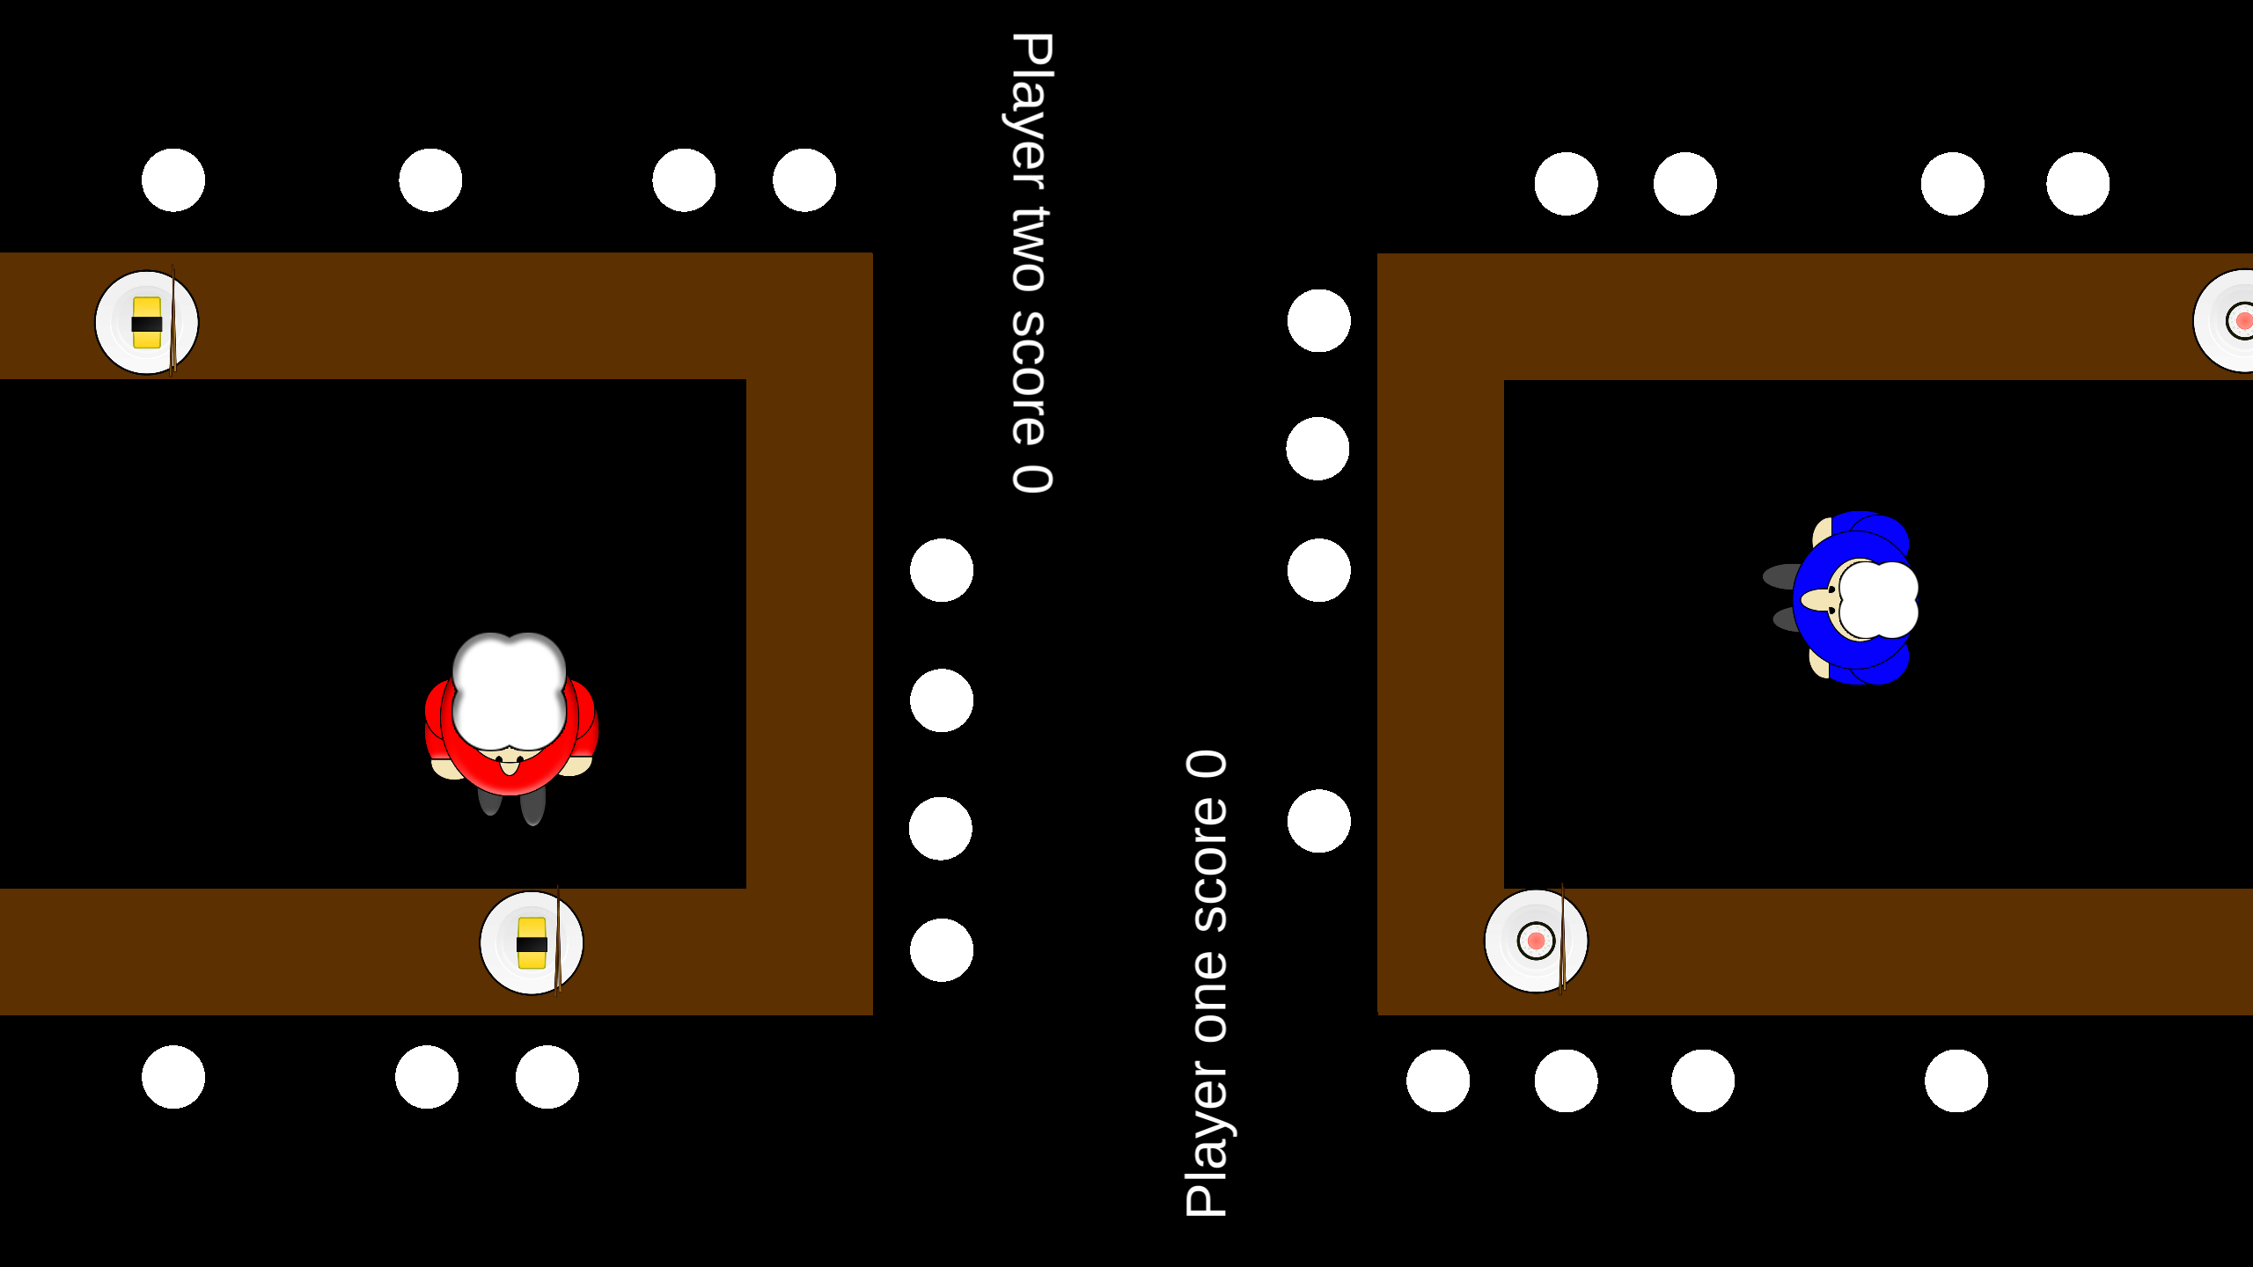

Latest Prototype / Features

Slide 6
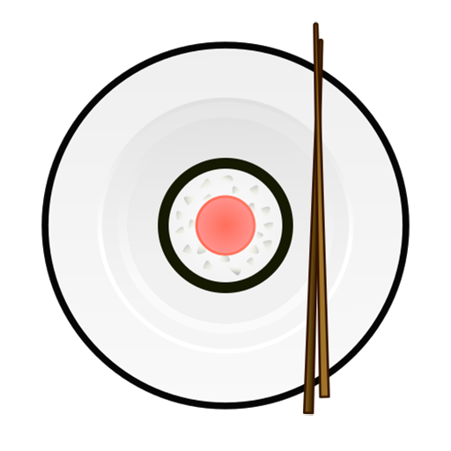

What does the player do?
Core game loop
Actions the player does

Slide 7
Where is the fun?
How do mechanics lead to fun?
How does theme lead to fun?
4 keys 2 fun?

Slide 8
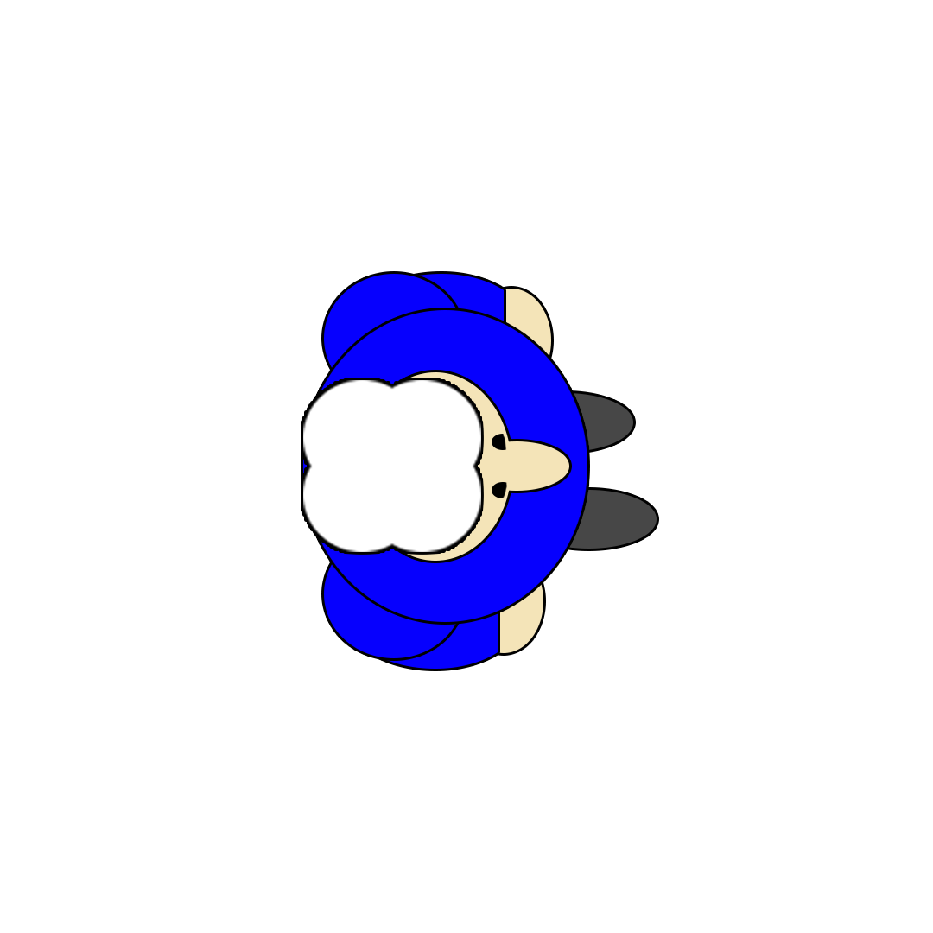
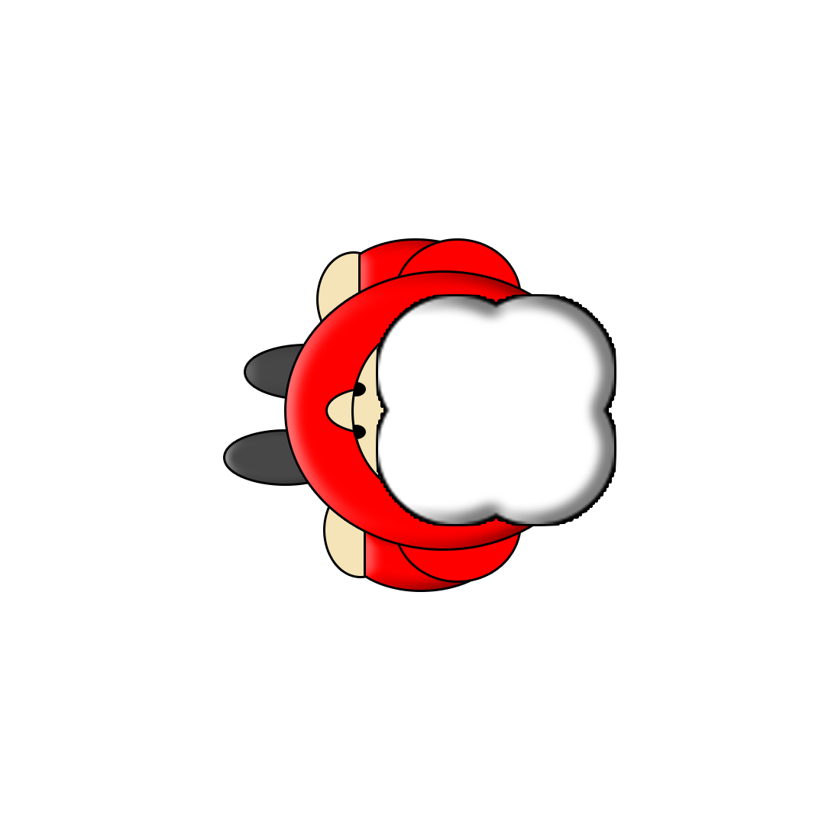
Questions?

